Slide 1
Dan Birman
2016-02-16
Frisem

Slide 2
What is it like to be a monkey?

Slide 3
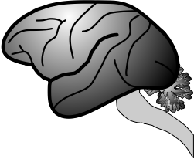
What is it like to be a monkey?

Slide 4
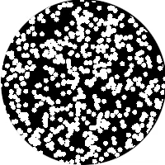
What is it like to be a monkey?

Slide 5
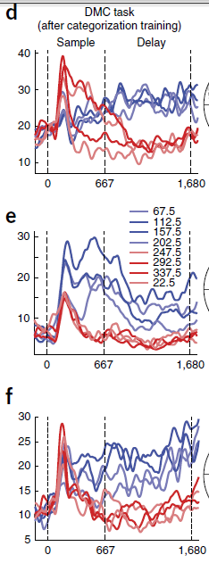
What is it like to be a monkey?

Slide 6
What is it like to be a monkey?

Slide 7
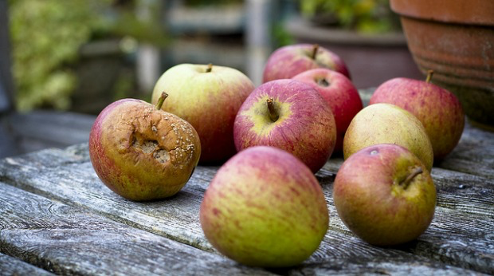

Slide 8
What is it like to be a monkey?

Slide 9
What is it like to be a monkey?
prospective student

Slide 10
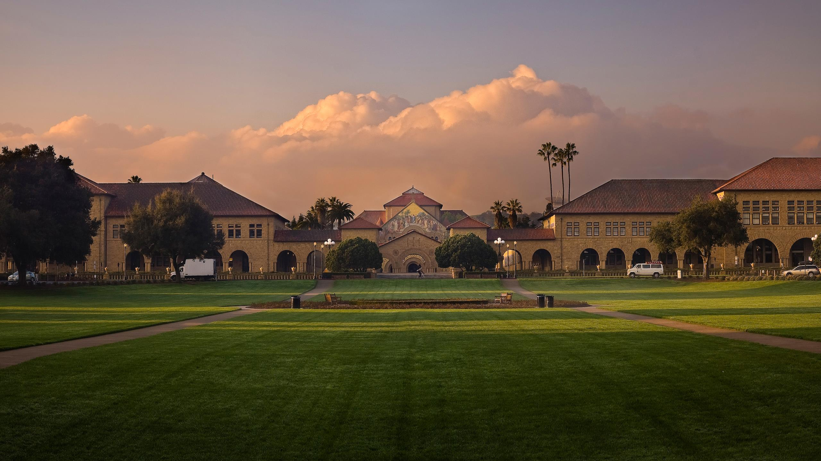

Slide 11
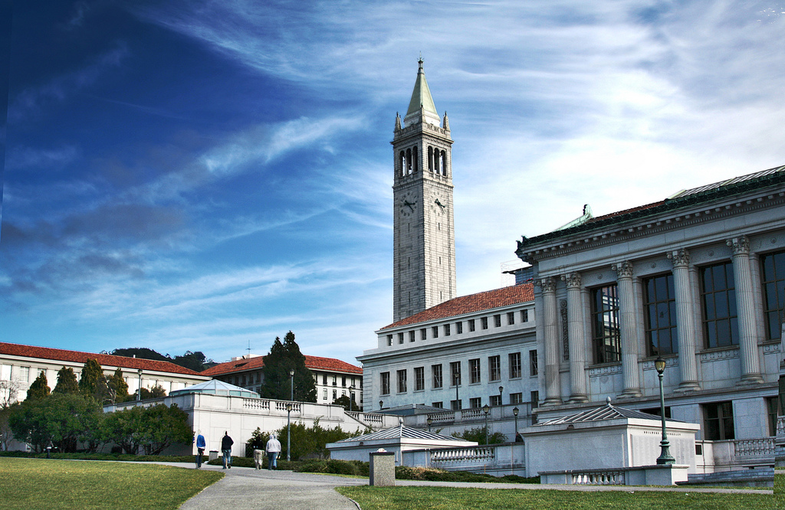

Slide 12
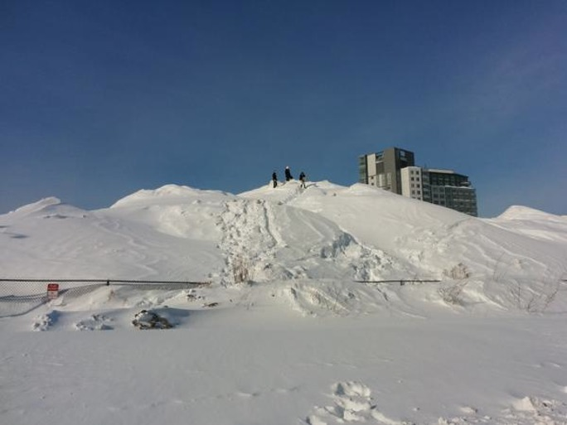

Slide 13
Criteria: Weather

Slide 14


Criteria: Weather

Slide 15
Criteria: Weather

Slide 16
Criteria: Number of Faculty

Slide 17
Criteria: # of Faculty

Slide 18
What is it like to be a monkey?
prospective student

Slide 19
What is it like to be a monkey?
prospective student

Slide 20
What is it like to be a monkey?
prospective student

Slide 21
What is it like to be a monkey?
prospective student

Slide 22
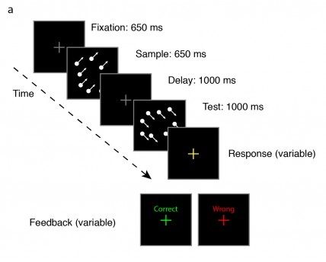

Slide 23
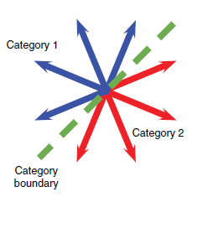

Slide 24
Categorization

Slide 25
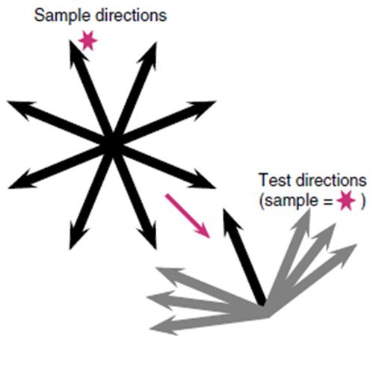
Categorization

Slide 26
Match to
Sample
Categorization

Slide 27
What is it like to be a monkey?

Slide 28
What is it like to be a monkey…
doing categorization?

Slide 30
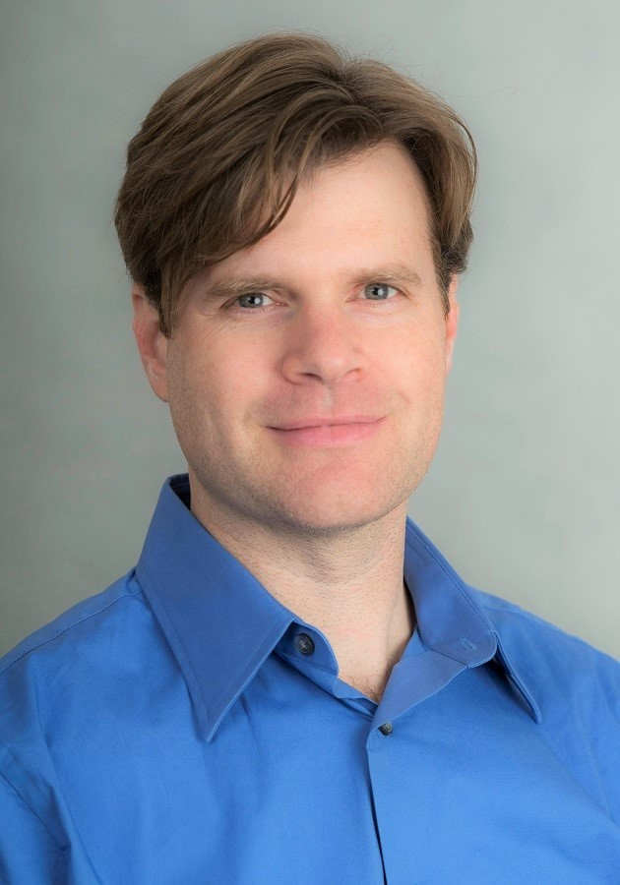

Arup Sarma, Nick Masse, X Wang, David Freedman @ U Chicago
David Freedman
Nick Masse

Slide 33
Sarma et al. 2016

Slide 35
Sarma et al. 2016

Slide 37
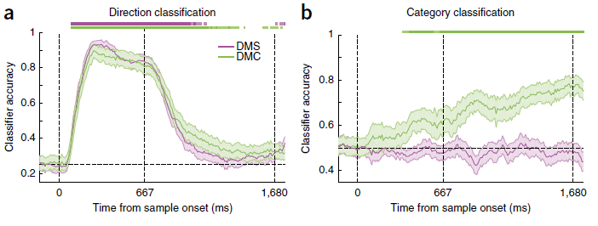

Slide 38
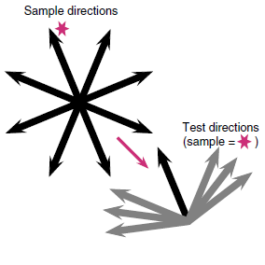
Sarma et al. 2016

Slide 39
Sarma et al. 2016

Slide 40
Sarma et al. 2016

Slide 41
Sarma et al. 2016

Slide 42
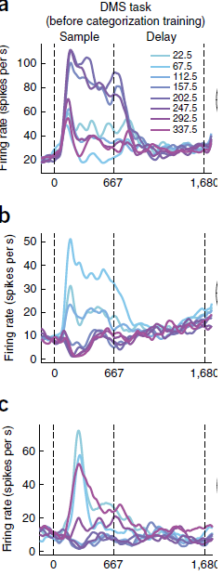

Slide 44
Match to Category
Match to Sample

Slide 45
What is it like to be a monkey?

Slide 46
What is it like to be a monkey?

Slide 47
What is it like to be a monkey?

Slide 48
What is it like to be a monkey?

Slide 49
What is it like to be a monkey?

Slide 50
What is it like to be a monkey?
A human… doing the same task

Slide 51
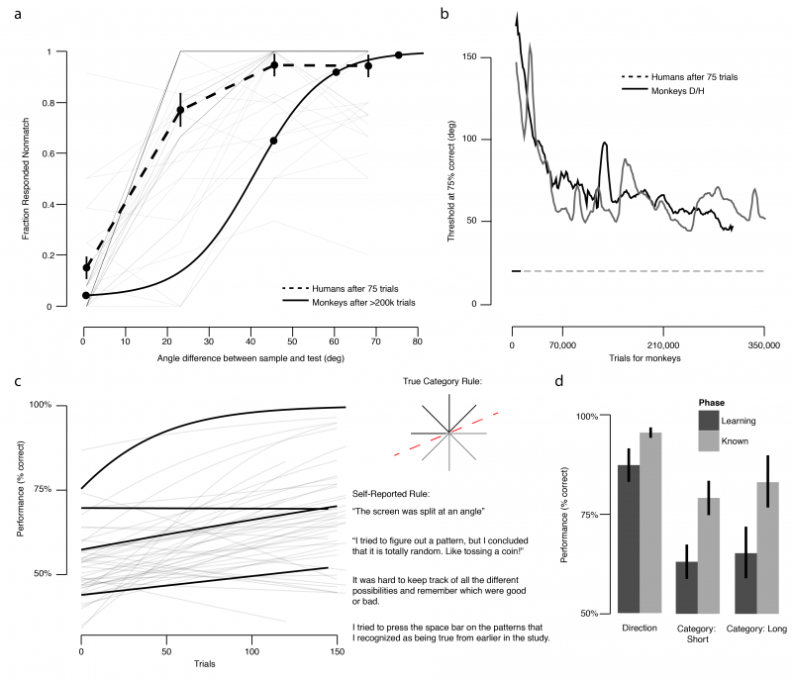

Slide 53
Threshold
~75% correct

Slide 59
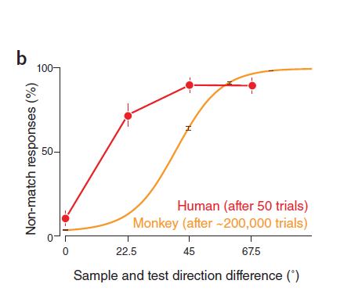
Birman & Gardner, Nat Neuro (2015)

Slide 60
Birman & Gardner, Nat Neuro (2015)

Slide 61
Birman & Gardner, Nat Neuro (2015)

Slide 62
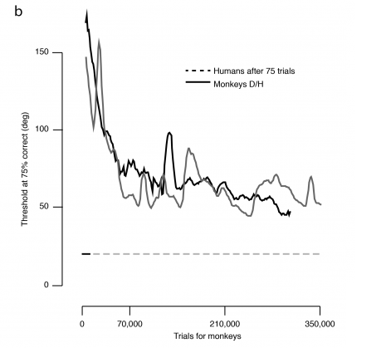

Slide 64
Human Performance (75 trials)

Slide 66
What is it like to be a monkey?
A human… doing the same task

Slide 67
What is it like to be a monkey?

Slide 68
What is it like to be a monkey?

Slide 69
What is it like to be a monkey?

Slide 70
What is it like to be a monkey?

Slide 71

Thank you!
Justin Gardner
Freedman Lab @ U Chicago
Nick Masse
David Freedman

